Slide 1
DOLLS ON A MISSION
CHERITON, VIRGINIA
Population 497

Slide 2
CHERITON BAPTIST CHURCH
WinGS
WOMEN in GODS SERVICE

Slide 3
Process:
There are about 12 to 15 women who meet once monthly for three hours, the dolls are sewn before the workshop. One group of ladie’s stuff the dolls, then another group glues the hair on and the hats. The final step is tying on the beads, adding the scarves and cards. The faces are hand painted. They average making about 40 dolls each month.

Slide 4
Organizing all the parts to the Dolls

Slide 5
Stuffing of the Dolls

Slide 6
Stringing of The Beads

Slide 7
Installing the beads, scarves and cards

Slide 8
Painting the Faces

Slide 9
Finished Product

Slide 10
First part of the journey. Cheriton, Virginia to Dunn, NC 241 miles.

Slide 11
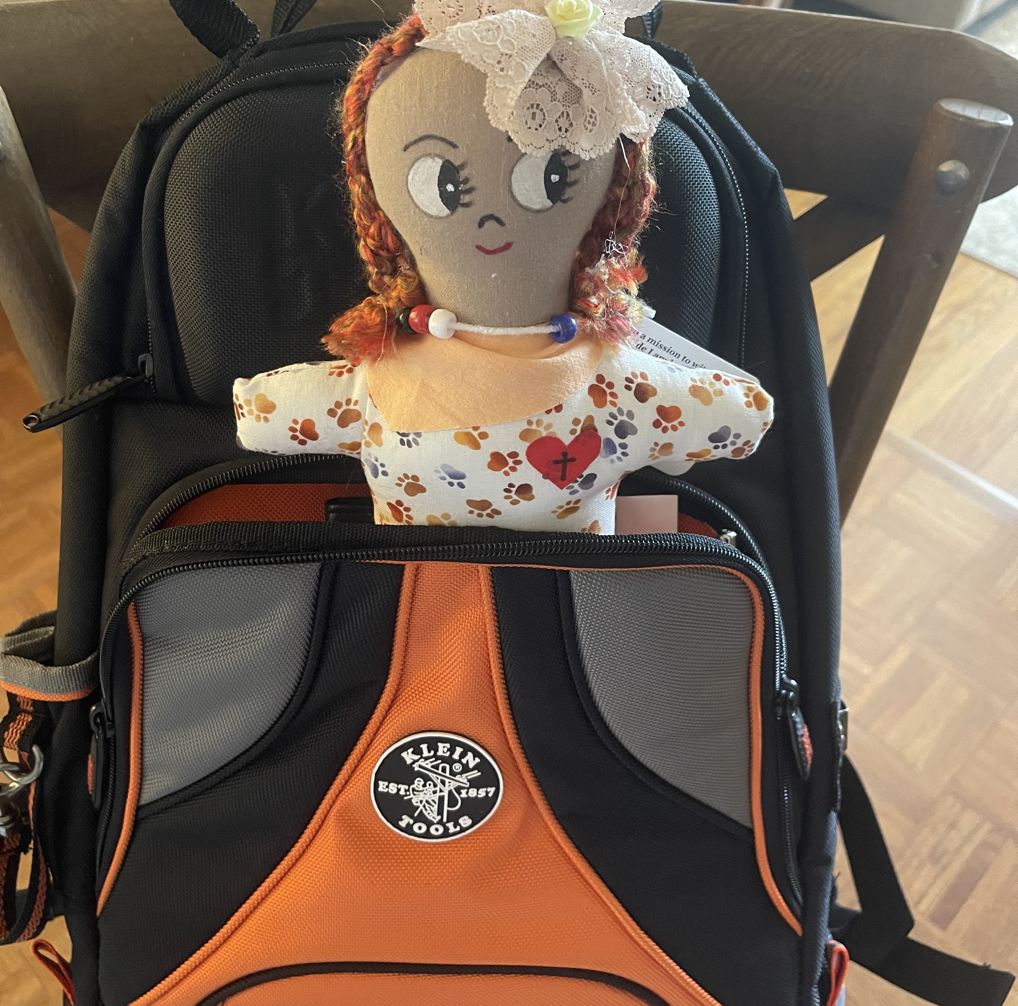
Leaving Dunn, NC for RDU Airport 55 Miles

Slide 12
Spending the night at Holiday Inn Express RDU Airport

Slide 13
Shuttle ride from Holiday Inn Express to RDU

Slide 14
Arriving at Miami International Airport from RDU 814. Miles

Slide 15
First presentation Miami International Airport

Slide 16
Arriving at Phillip SW Goldson International Airport, Belize City Belize from Miami.

Slide 17
Final Destination, Santa Clara Village, Corozal Belize, CA 74 Miles From Belize Airport

Slide 18
Presentation to children

Slide 19
Iglesia Bautista Getsemini de Santa Clara

Slide 20
Spreading Jesus’s love in Belize.

Slide 21
I traveled 1949 miles to spread the love of Jesus to the children of Santa Clara Belize. I hope you have enjoyed the ride with me.

